Slide 1
Chapter 8
The Client-Server Model – Section 1

Slide 2
Overview - 1
Client-Server Overloaded Term
The Client-Server Paradigm.
The Client-Server Paradigm Issues:
  Service Session.
  Protocol of the Service (Existing RFC; New):
    Location of service.
    Sequence of IPC.
    Data representation.

Slide 3
Overview - 2
Software Engineering for a Network Service:
  Application Components – Client & Server.
  Software Architecture:
    Presentation Layer.
    Application Logic layer.
    Service Layer.
  Documenting using UML diagrams.
Daytime Example:
  Client-Server using Connectionless Datagram (UDP socket).
  Client-Server using Stream-mode socket (TCP socket).

Slide 4
Client-Server Overloaded Term
Term client-server has multiple meanings in computing:
  Network architecture – computers on network function in different roles in order to share resources.
  Client-server architecture - a computer dedicated to managing resources so that remote computers (clients) can access those resources.
C/S architecture is NOT the subject of this chapter (although related).
Concerned with the client/server paradigm.

Slide 5
Client-Server Overloaded Term - 2
Client/Server paradigm refers to a model for network applications where processes play one of two different roles.
Server process (server for short) – dedicated to managing access to some network service.
Client process (client for short) – accesses the server to obtain the network service.

Slide 6
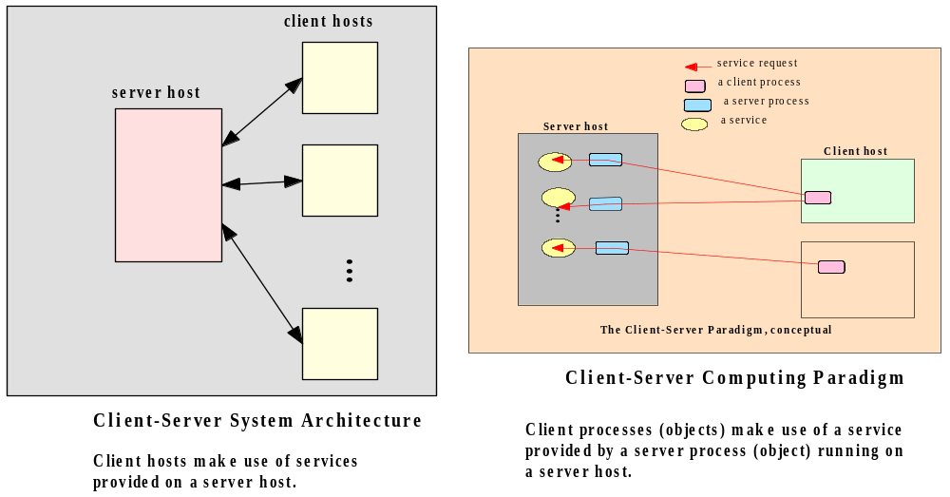
Client-Server Overloaded Term - 3

Slide 7
The Client-Server Paradigm - 1
A server process - running on a server host provides access to a service.
A client process - running on a client host - accesses the service via the server process.

Slide 8
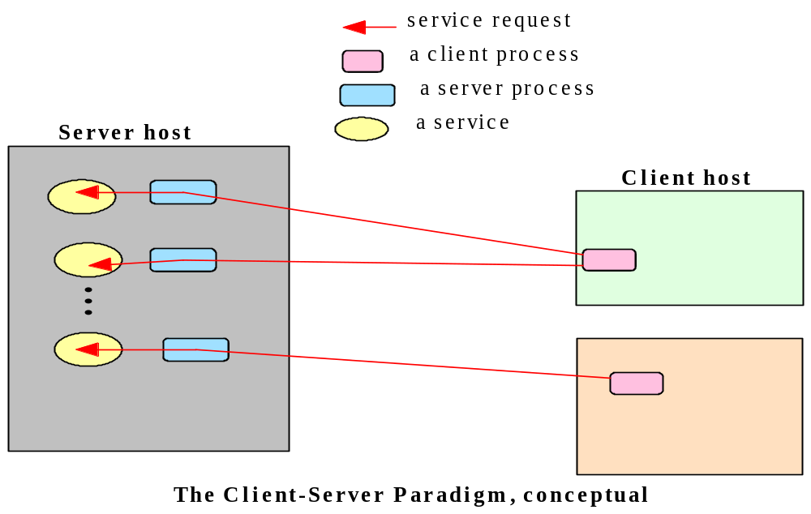
The Client-Server Paradigm - 2

Slide 9
The Client-Server Paradigm - 3
Client-server model is designed for providing network services.
A service provided to allow network users to share resources.
Trivial – retrieving time from a server.
Complex – retrieving files in a specific file system, data from a database.
Examples: Telnet, FTP, Daytime, HTTP.

Slide 10
Client/Server Paradigm Issues
There are a number of issues that need to be addressed when it comes to implementing the client/server paradigm.
  Service session.
  Protocol for the service.

Slide 11
Service Session - 1
In the context of the client-server model - session refers to the interaction between the server and one client.
Service managed by a server may be accessed by multiple clients who desire the service, sometimes concurrently.
Each client, when serviced by the server, engages in a separate session with the server.

Slide 12
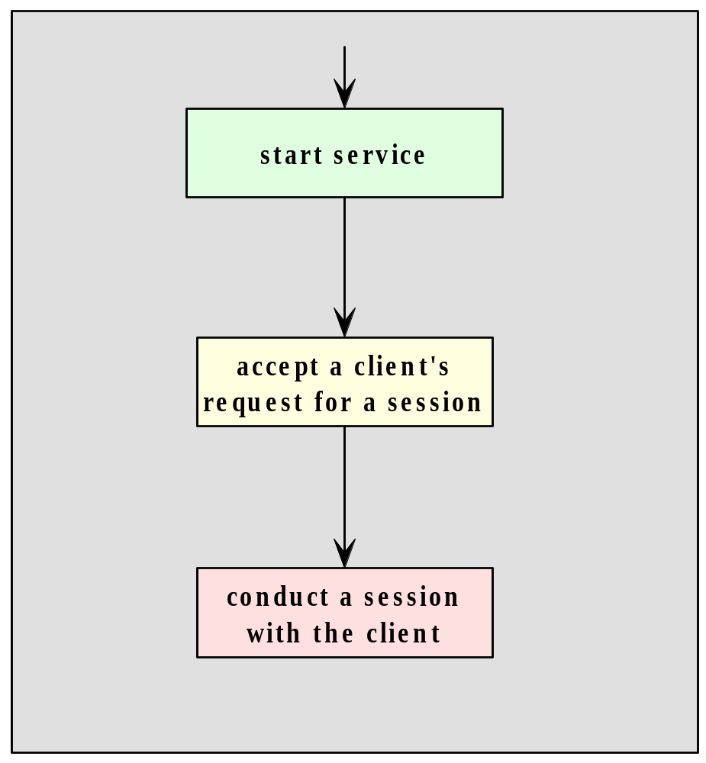
Service Session Execution Flow

Slide 13
Protocol for a Service
A protocol is needed to specify the rules that must be observed by the client and the server during a session of the service.
Rules include specifications on:
  how the service is to be located;
  the sequence of inter-process communication;
  the representation and interpretation of data exchanged.
On the Internet, such protocols are specified in the RFC’s (Request for Comment).

Slide 14
RFC’s
http://www.ietf.org/rfc.html
daytime: http://tools.ietf.org/html/rfc867
ftp: http://www.ietf.org/rfc/rfc959.txt
telnet: http://www.ietf.org/rfc/rfc854.txt
http: http://www.ietf.org/rfc/rfc2616.txt
smtp: http://www.ietf.org/rfc/rfc0821.txt

Slide 15
Locating the Service
Mechanism must be available to allow a client process to locate a server for a given service.
Simple scheme – service location is static – can be addressed using the address of the server process (host name and protocol port number assigned to the server process).
Higher level of abstraction - service identified using a logical name registered with a registry - need to be mapped to the physical location of the server process. If the mapping is performed at runtime possible for the service’s location to be dynamic - location transparent.

Slide 16
Inter-process Communication
In C/S model the interaction between processes follows the request-response protocol.
Client makes request – server replies with a response. Pattern repeated until session end.
Example(s):
  Daytime service (timestamp).
  WWW (HTTP request & responses).

Slide 17
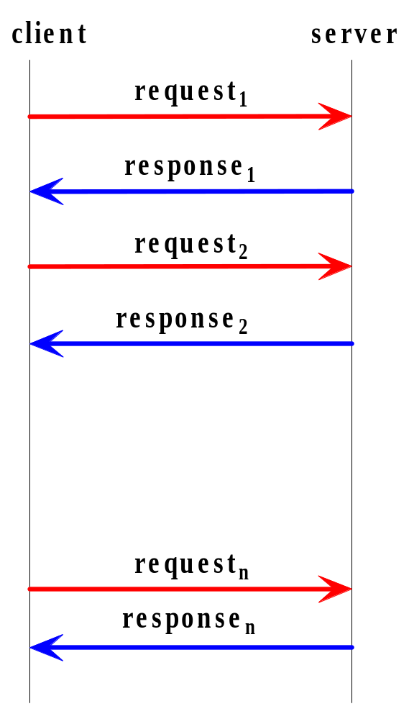
The interprocess communications and event synchronization

Slide 18
Session Dialog Examples
Daytime service session
Client: Hello, <client address> here. May I have
a timestamp please.
Server: Here it is: (time stamp follows)
World Wide Web session:
Client: Hello, <client address> here.
Server: Okay. I am a web server and speaks protocol HTTP1.0.
Client: Great, please get me the web page index.html at the root of your document tree.
Server: Okay, here’s what’s in the page: (contents follows).

Slide 19
Inter-process Communication
Dialog in each session follows a pattern prescribed in the protocol specification for the service - RFC.
Daytime – RFC 867.
Sequence diagram – used to document inter-process communication.

Slide 20
Data Representation
Part of the specification of a protocol is the syntax and semantics of each request and response.
The choice of data representation depends on the nature and the needs of the protocol
Daytime – uses text-mode representation – see RFC 867.
Representing data using text (character strings) is common, as it facilitates data marshalling and allows the data to be readable by human.
Most well known Internet protocols are client-server, request-response, and text-base.
All RFC’s - http://www.ietf.org/rfc.html

Slide 21
Software Engineering for a Network Service
We will now examine a methodology for creating a network service.
We will examine:
  Two sets of software involved (can be developed separately):
    Client-side software – client process.
    Server-side software – server process.
  Software Architecture.
  Documenting the solution with UML diagrams.
Look at the Daytime protocol.

Slide 22
Software Architecture - 1
Use the three-layer software architecture for network applications
Functionality of the application can be divided into three layers:
  Presentation.
  Application.
  Service.
Functionalities of three layers must be present in the combined s/w.
Three layers are encapsulated in different software modules/source files.

Slide 23
Software Architecture - 2
Presentation Layer:
  Server-side – UI (user interface) – required to allow the process to start – normally command-line.
  Client-side – needs UI – request a service and receive responses.
Application Layer:
  Server-side – time of day needs to be obtained and sent to client process.
  Client-side – request from user needs to be sent to server and the response needs to be displayed to user.

Slide 24
Software Architecture - 3
Service layer:
  Both sides – the IPC mechanism (here sockets).

Slide 25
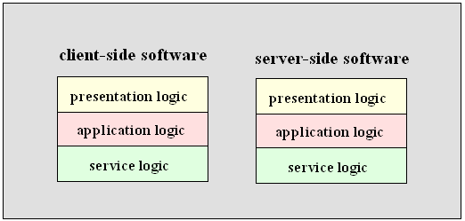
Software Architecture - 4

Slide 26
Benefits of Software Layering
Allows each module to be developed by people with special skills.
Developers can focus on a module that they have expertise – UI, app logic, service.
Allows modifications to be made to the logic at the presentation without requiring changes to be made at the lower layers.
Control Complexity of software design

Slide 27
Daytime Network Service
We will use the Daytime protocol (RFC 867) to illustrate the development process.
We will examine two versions of the network service:
  Client-Server using Connectionless Datagram (UDP socket).
  Client-Server using Stream-mode socket (TCP socket).
We will examine each of the three layers in both the client-side and the server-side software.

Slide 28
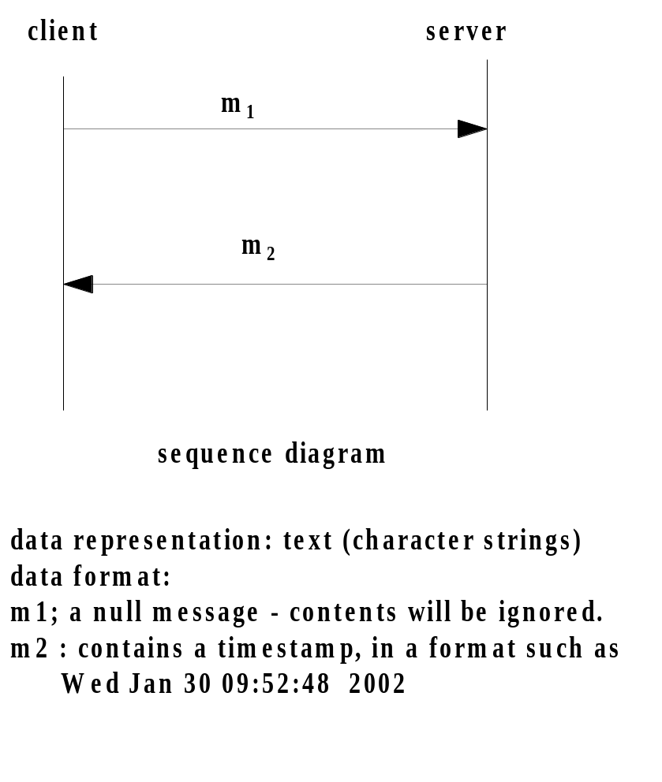
Daytime protocol

Slide 29
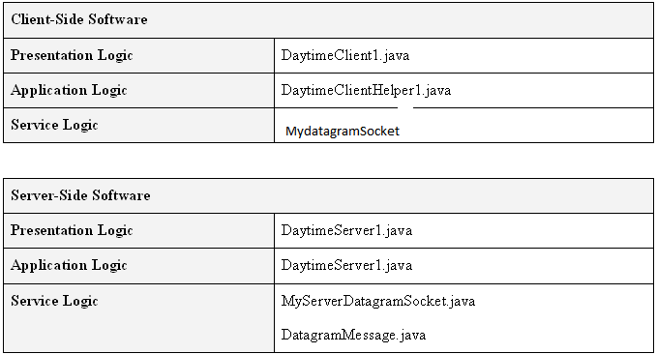
Daytime C/S – Connectionless Datagram – Source Files
Note: No substantial presentation code used.

Slide 30
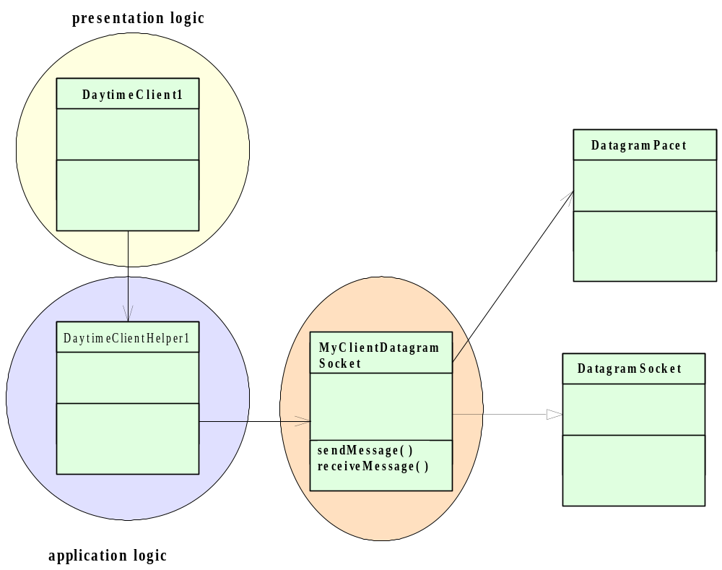
Daytime C/S - UML Diagram - Daytime Client

Slide 31
Excerpt from DaytimeClient1
public class DaytimeClient1 {
public static void main(String[] args) {
…
try {
…
hostName = "localhost";
portNum = "13"; // default port number
System.out.println("Here is the timestamp received from the server"
+ DaytimeClientHelper1.getTimestamp(hostName, portNum));
} // end try

Slide 32
Excerpt from
public class DaytimeClientHelper1 {
public static String getTimestamp(String hostName,
String portNum){
String timestamp = "";
try {
InetAddress serverHost = InetAddress.getByName(hostName);
int serverPort = Integer.parseInt(portNum);
// instantiates a datagram socket for both sending and receiving data
MyDatagramSocket mySocket = new MyDatagramSocket();
mySocket.sendMessage( serverHost, serverPort, "");
// now receive the timestamp
timestamp = mySocket.receiveMessage();
mySocket.close( );
return timestamp;

Slide 33
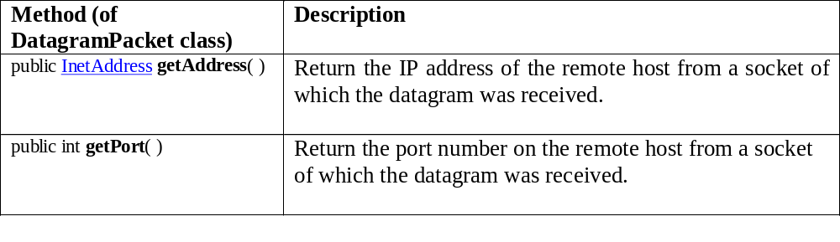
The getAddress and getPort Methods

Slide 34
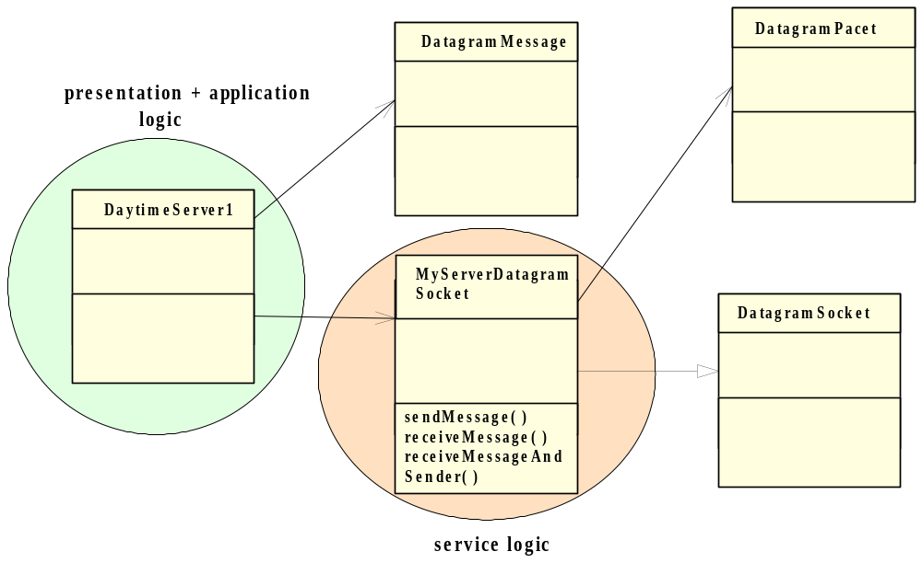
Daytime C/S - UML Diagram - Daytime Server

Slide 35
Excerpt from DaytimeServer1
public class DaytimeServer1 {
public static void main(String[] args) {
int serverPort = 13; // default port
…
try {
// instantiates a datagram socket for both sending and receiving data
MyServerDatagramSocket mySocket = new MyServerDatagramSocket(serverPort);
while (true) { // forever loop
DatagramMessage request = mySocket.receiveMessageAndSender();
// The message received is unimportant; it is the sender's address that we need in order to reply.
// Now obtain the timestamp from the local system.
Date timestamp = new Date ();
// Now send the reply to the requestor
mySocket.sendMessage(request.getAddress( ), request.getPort( ), timestamp.toString( ));

Slide 36
Daytime C/S – Stream Mode
Previously we create a Daytime client/server application using connectionless datagram (i.e. UDP socket).
What would we need to change if we wanted to implement the same service using stream socket (i.e. TCP socket) ?
Make extensive changes to the service logic (and minor adjustments to the application logic).

Slide 37
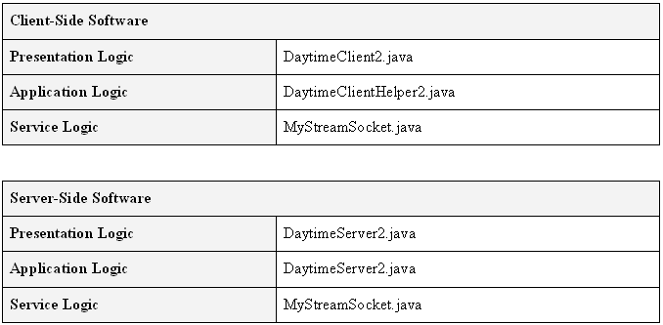
Daytime C/S – Stream Mode – Source Files
Note: No substantial presentation code used.

Slide 38
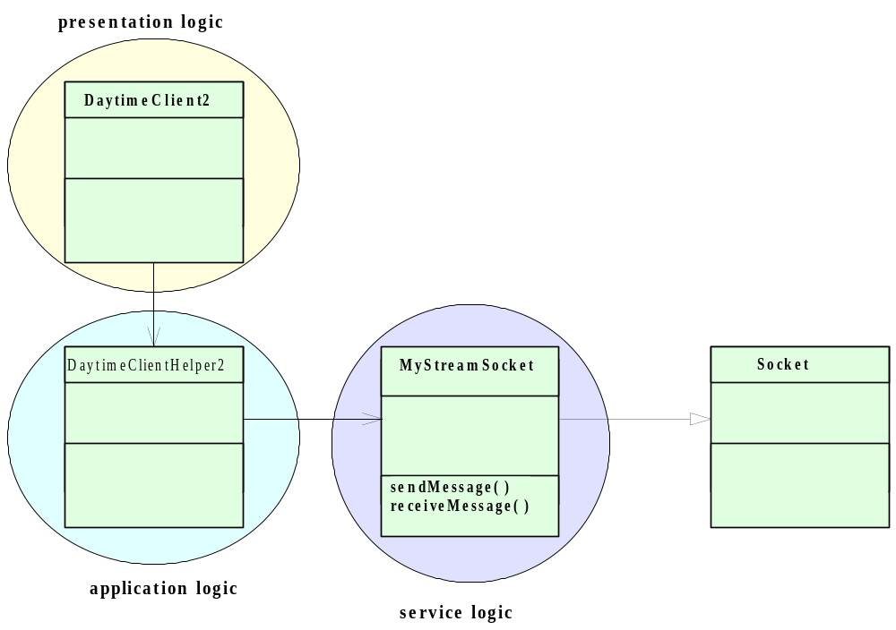
Daytime C/S - UML Diagram - Daytime Client

Slide 39
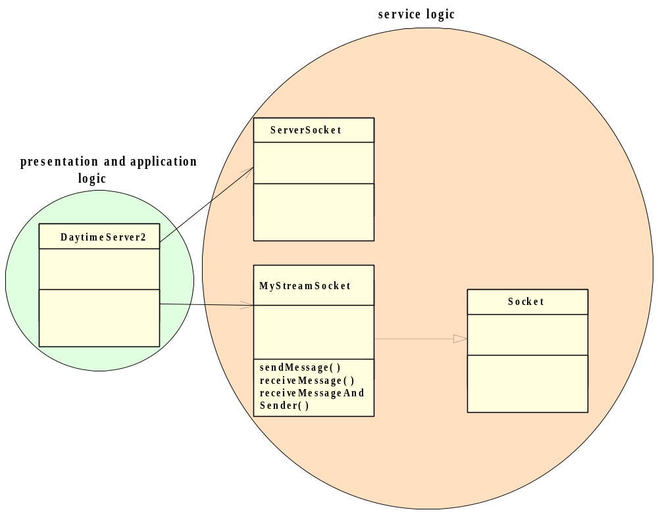
Daytime C/S - UML Diagram - Daytime Server

Slide 40
Excerpt from DaytimeClient2
public class DaytimeClient2 {
public static void main(String[] args) {
try {
hostName = "localhost"; // use the default host name
portNum = "13"; // default port number
System.out.println("Here is the timestamp received from the server"
+ DaytimeClientHelper2.getTimestamp(hostName, portNum));

Slide 41
Excerpt from DaytimeClientHelper2
public class DaytimeClientHelper2 {
public static String getTimestamp(String hostName, String portNum) throws Exception{
String timestamp = "";
InetAddress serverHost = InetAddress.getByName(hostName);
int serverPort = Integer.parseInt(portNum);
// instantiates a stream mode socket and wait to make a connection to the server port
MyStreamSocket mySocket =
new MyStreamSocket(serverHost, serverPort);
// now wait to receive the timestamp
timestamp = mySocket.receiveMessage();
mySocket.close( ); // disconnect is implied
return timestamp;

Slide 42
Excerpt from DaytimeServer2
public class DaytimeServer2 {
public static void main(String[] args) {
int serverPort = 13; // default port
try {
// instantiates a stream socket for accepting connections
ServerSocket myConnectionSocket = new ServerSocket(serverPort);
while (true) { // forever loop
// wait to accept a connection
MyStreamSocket myDataSocket = new MyStreamSocket(myConnectionSocket.accept( ));
// Note: there is no need to read a request – the request is implicit.
Date timestamp = new Date ();
// Now send the reply to the requestor
myDataSocket.sendMessage(timestamp.toString( ));
myDataSocket.close( );

Slide 43
Testing a Network Service - 1
Network software is difficult to test - inherent complexity.
Guidelines:
  Use the three-layered software architecture and modularise each layer on both the client and the server sides.
  Use an incremental or stepwise approach in developing each module. Start with stubs for each method, compile and test a module after each iteration in functionality.

Slide 44
Testing a Network Service - 2
  Develop the client first.
    Employ an Echo server (to be introduced in the next section) which is known to be correct and which uses a compatible IPC mechanism to test the client independent of the server.
    Allows you to develop the client independent of the server.
  Use diagnostic messages throughout each program to report the progress of the program during runtime.
  Test the client-server suite on one machine before running the programs on separate machine.

Slide 45
Review - 1
Client-Server Overloaded Term
The Client-Server Paradigm.
The Client-Server Paradigm Issues:
  Service Session.
  Protocol of the Service (Existing RFC; New):
    Location of service.
    Sequence of IPC.
    Data representation.

Slide 46
Review - 2
Software Engineering for a Network Service:
  Application Components – Client & Server.
  Software Architecture:
    Presentation Layer.
    Application Logic layer.
    Service Layer.
  Documenting using UML diagrams.
Daytime Example:
  Client-Server using Connectionless Datagram (UDP socket).
  Client-Server using Stream-mode socket (TCP socket).

